Slide 1

Department of Computer Science and Engineering Project Work Phase 2 PROJECT TITLE Fraud Shield AI
VISVESVARAYA TECHNOLOGICAL UNIVERSITY - BELAGAVI
Accredited by NBA
Students Name:
Ms. Pranjal Bhinge(2BU21CS086)
Ms. Ranjeeta Chikkaparappa(2BU21CS101)
Mr. Rohan Pawar(2BU21CS108)
Ms. Shruti Basarikatti(2BU21CS141)
Guide Name:
Name: Mrs. Vidya Shahapurkar
Designation: Assistant Professor

Slide 2
Introduction
In the era of rapidly growing digital transactions and online communications, financial and cybersecurity threats are evolving at an alarming rate. Fraudulent UPI transactions, fake QR codes, PDF-based malware attacks, and phishing scams have emerged as major concerns, risking financial losses and personal data breaches.
This project presents a comprehensive multi-domain fraud detection system designed to predict and identify such fraudulent activities effectively. The system leverages machine learning techniques to analyze transaction patterns, document contents, and QR code authenticity, providing predictive analysis through an interactive Streamlit dashboard supported by Flask APIs.

Slide 3
Literature Survey
S.NO | AUTHORS/YEAR | TITLE | OBSERVATIONS
1 | Zhao et al., 2024 | Deep Learning-Based UPI Fraud Detection | This study proposes a deep learning-based model to analyze transactional patterns and detect anomalies in UPI payments, achieving high accuracy in fraud detection.
2 | Kumar & Singh, 2023 | QR Code Fraud Detection Using Computer Vision | The paper explores the application of OpenCV and deep learning methods to analyze QR codes and detect deceptive or manipulated codes used in financial fraud.
3 | Gupta et al., 2024 | PDF Malware Detection Using AI and Metadata Analysis | This work presents a hybrid AI model that examines metadata, embedded scripts, and document structures to detect malicious PDFs. It compares traditional signature-based approaches with AI-driven detection.
4 | Patel et al., 2023 | Phishing Email Detection Using Natural Language Processing | This study demonstrates an advanced NLP-based phishing detection model capable of identifying suspicious links and fraudulent email patterns with high precision.

Slide 4
Contd…
S.NO | AUTHORS/YEAR | TITLE | OBSERVATIONS
5 | Verma & Joshi, 2024, | Enhancing Transaction Security in Digital Payments | The research proposes a blockchain-supported mechanism for securing digital payments and reducing fraudulent transactions through decentralized validation.
6 | Bansal & Iyer, 2024 | Fraud Analytics for Digital Banking Security | This work presents a comprehensive fraud detection framework integrating AI, behavioral analysis, and cybersecurity techniques for financial fraud prevention.
7 | Bodade et al., 2024 | Machine Learning-Based Fraud Detection in Digital Payments | This paper discusses the application of machine learning models to detect fraudulent activities in digital payment systems, including UPI transactions.
8 | Lamgade et al., 2024 | Advanced PDF Malware Detection Using AI | The study introduces AI-driven techniques for detecting malware in PDF documents, focusing on behavioral analysis and metadata inspection.
9 | Edburg et al., 2024 | AI-Driven UPI Fraud Detection in Global Digital Payments | This study explores AI-based fraud detection techniques for UPI transactions, comparing fraud trends across different countries and proposing a scalable detection model.

Slide 5
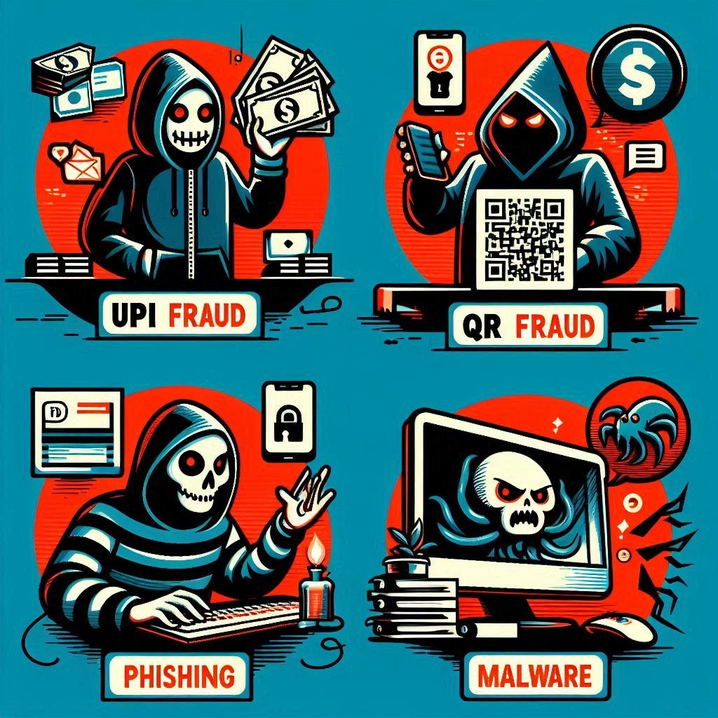
Problem Statement
Rising digital fraud, including UPI scams, fake QR codes, malware-laden PDFs, and phishing attacks, poses significant financial and security risks.
Existing individual detection methods often fail to provide a holistic and integrated defense against these diverse yet interconnected threats.
There is a need for a unified, intelligent system capable of analyzing various data types to proactively identify and predict these fraudulent activities.

Slide 6
Objectives
To accurately identify fraudulent UPI transactions by analyzing transaction patterns.
To effectively detect malicious and deceptive QR codes through intelligent image analysis.
To successfully identify malware concealed within PDF documents by examining file characteristics.
To reliably recognize phishing attempts by scrutinizing digital communication content.
To present clear and actionable fraud predictions through an intuitive Streamlit dashboard.
To develop a unified dashboard for the integrated visualization of multi-domain digital fraud analysis results.

Slide 7
Specific Requirements
Frontend: ➔ Streamlit (Python-based interactive UI)
Backend: ➔ Flask (API server for handling requests)
Authentication: ➔ Firebase Authentication (user login/signup)
Database: ➔ MongoDB (Cloud via Atlas / Local for storage)
Libraries/Packages Used: ➔ Pandas (data handling) ➔ Scikit-learn (machine learning models) ➔ NumPy (numerical operations) ➔ Pyrebase (Python wrapper for Firebase) ➔ Streamlit (web app framework) ➔ Joblib (model saving/loading)
UI Framework: ➔ Streamlit (for building the entire frontend)
Programming Language: ➔ Python 3.10+

Slide 8
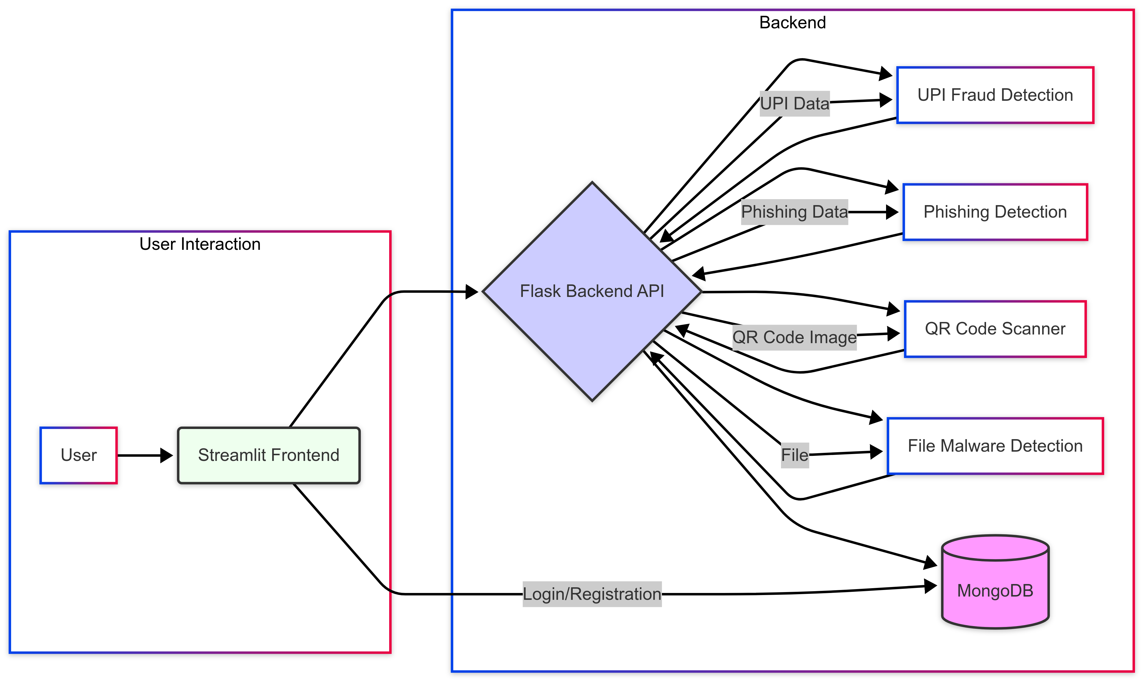
Architecture Diagram

Slide 9
Design Modules
Module No. | Module Name | Description
1 | UPI Fraud Detection | Analyze UPI transactions to detect fake payments and frauds
2 | QR Code Fraud Detection | Detect fake QR codes through image classification
3 | PDF Malware Detection | Detect malicious PDF files embedded with malware
4 | Phishing Detection | Detect suspicious links

Slide 10
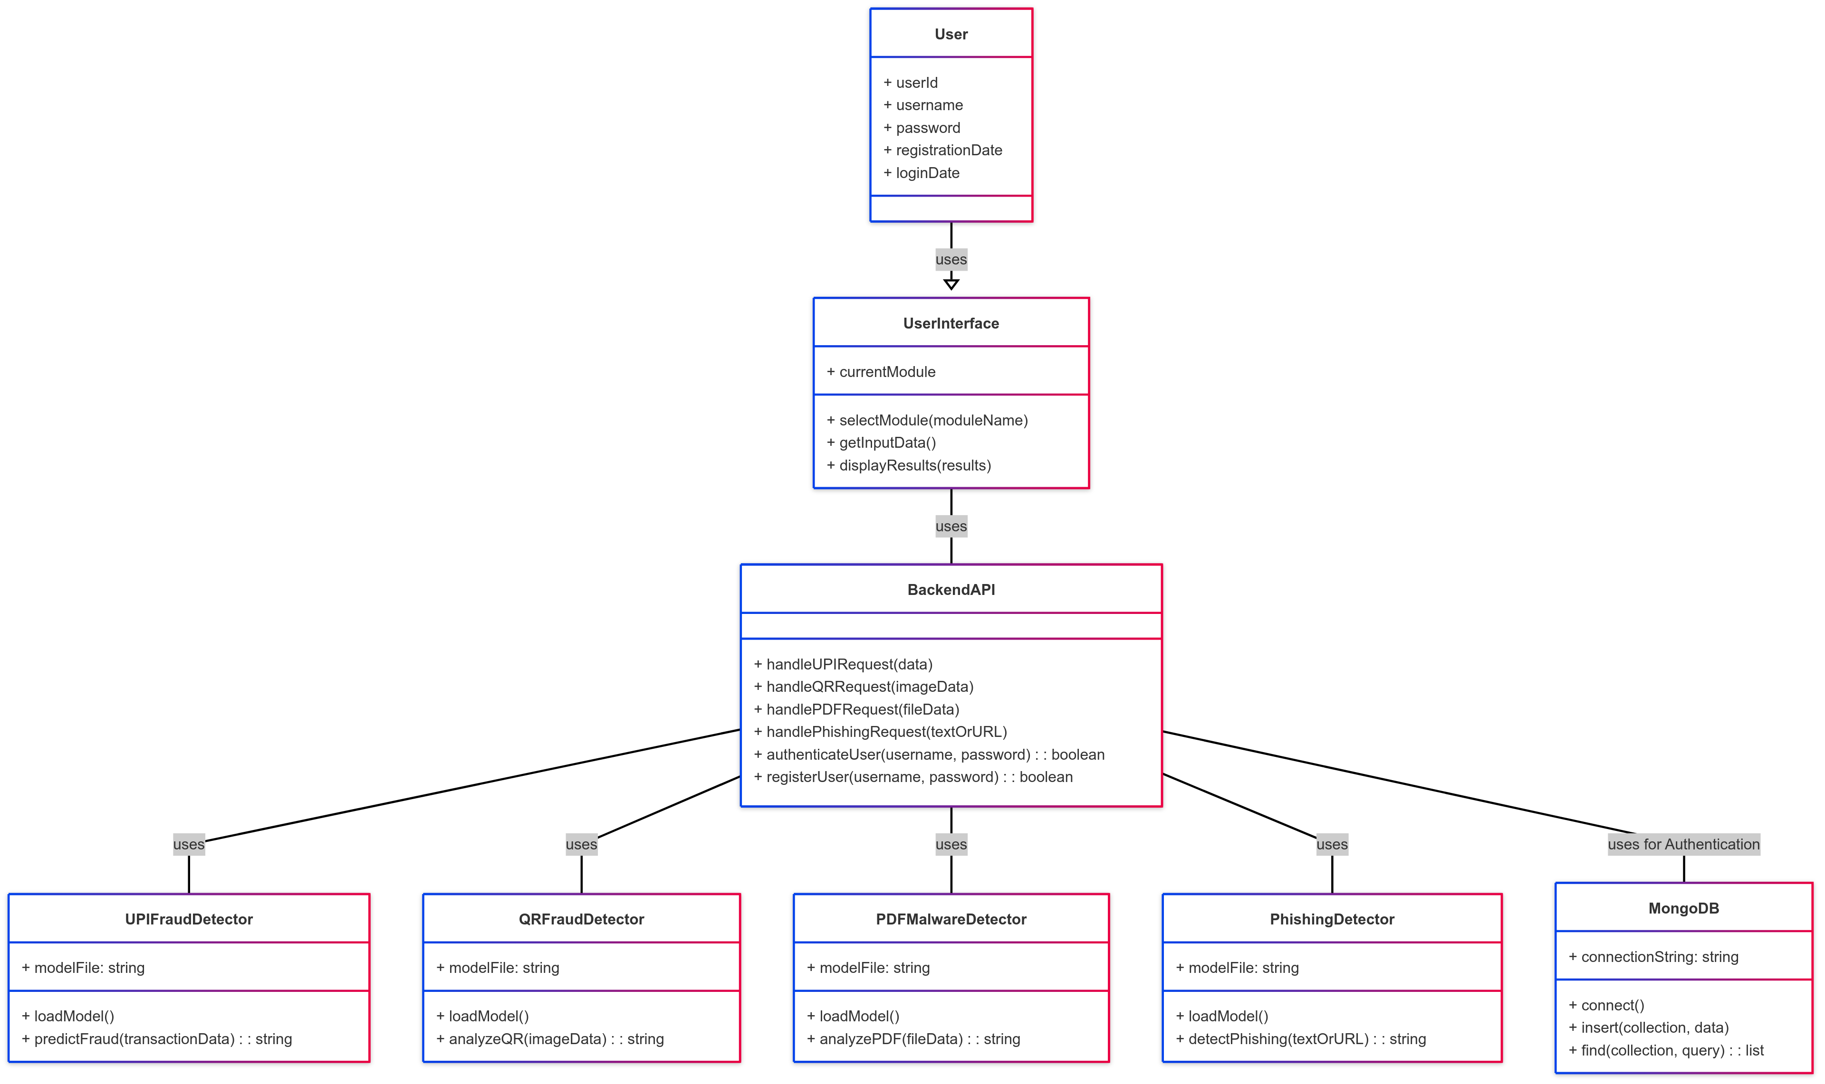
Class Diagram

Slide 11
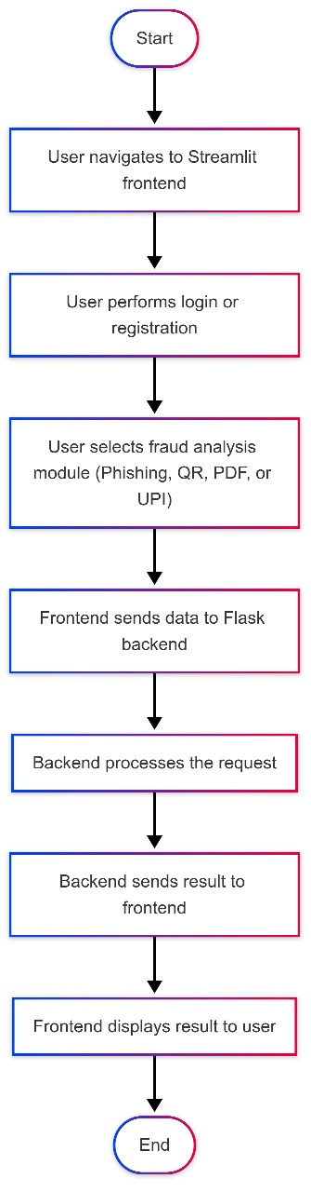
Activity Diagram

Slide 12
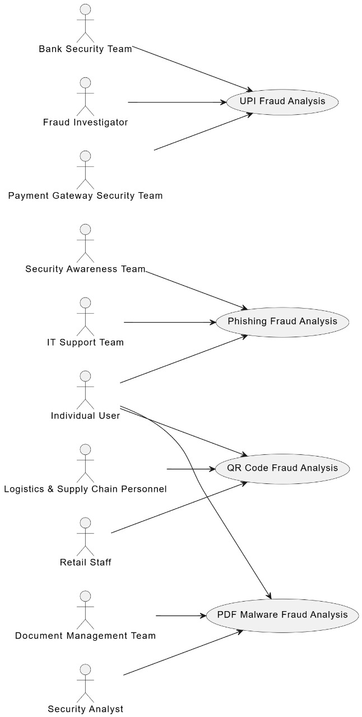
Use Case Diagram

Slide 13
Results
Unified Fraud Detection: System tackles UPI, QR, PDF, & Phishing threats.
ML Models & Dashboard: Developed AI for each fraud type; user-friendly Streamlit interface.
UPI Fraud (RF): 85-95% accuracy on well-prepared datasets.
Phishing (Gemini 1.5-Flash API): 90-98% detection accuracy depending on dataset quality.
QR Fraud (OpenCV): 90-100% accuracy for QR code detection; further analysis needed for fraud detection.
PDF Malware (Signatures + Metadata): 75-90% accuracy for known malware; lower for new threats.
Multi-Domain Prediction: Demonstrated predictive analysis across different fraud vectors.
Interactive Dashboard: Provided a user-friendly interface for visualizing fraud predictions.
Foundation for Future: Laid groundwork for potential real-time integration.
Static Datasets: Utilized static datasets to simulate real-world scenarios effectively

Slide 14
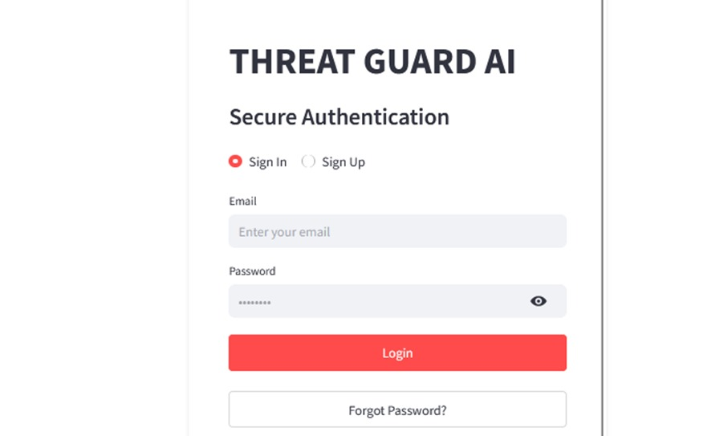
Outcome Snapshots
Sign-in/Sign-up Page

Slide 15
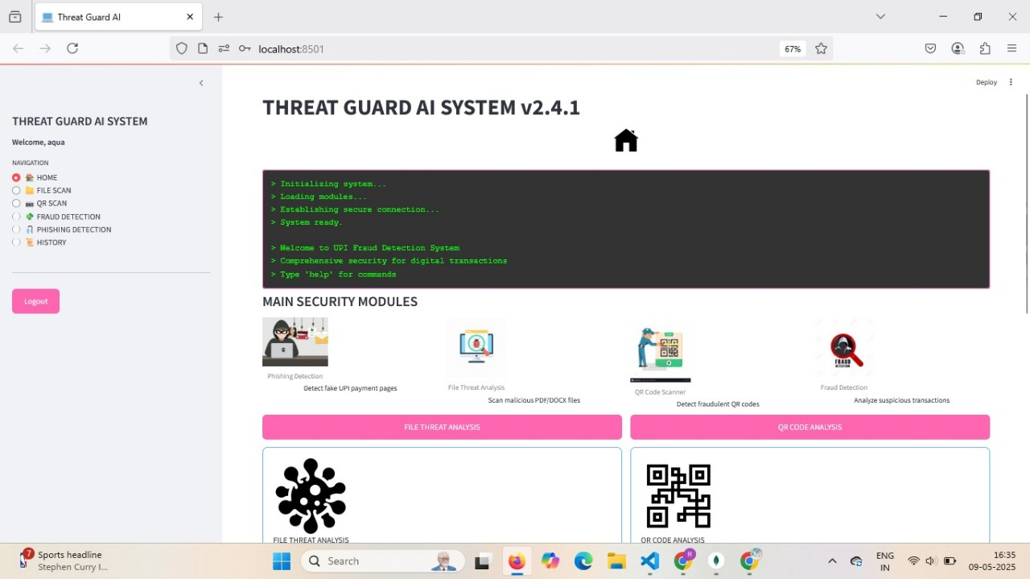
Home page with Header

Slide 16
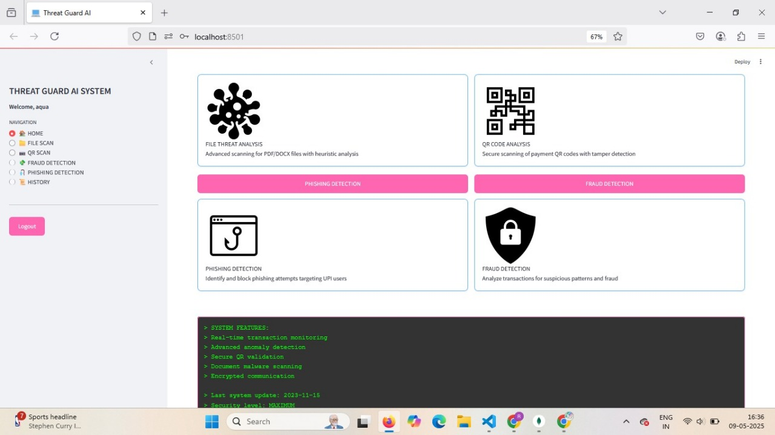
Home page with Footer

Slide 17
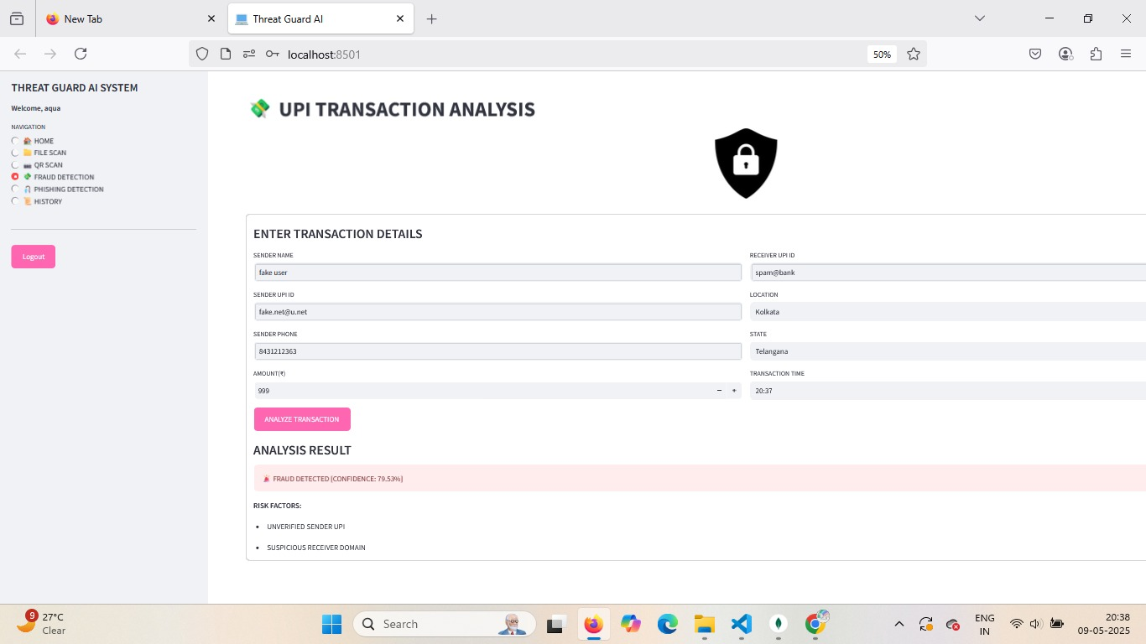
UPI Fraud Detection - Unsafe

Slide 18
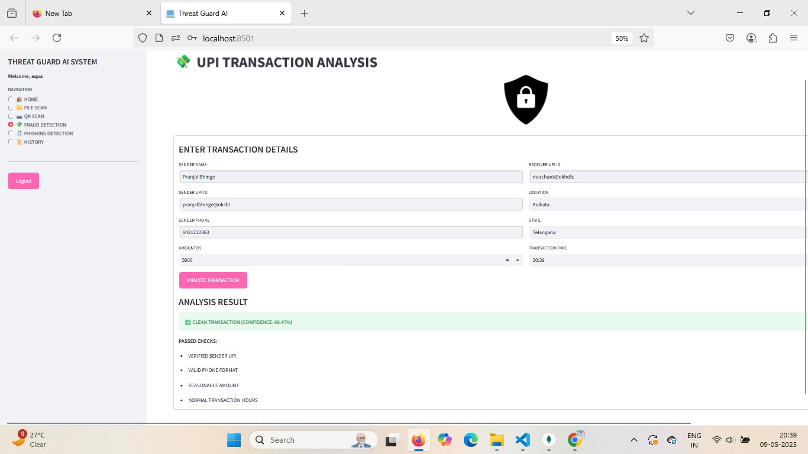
UPI Fraud Detection – Safe

Slide 19
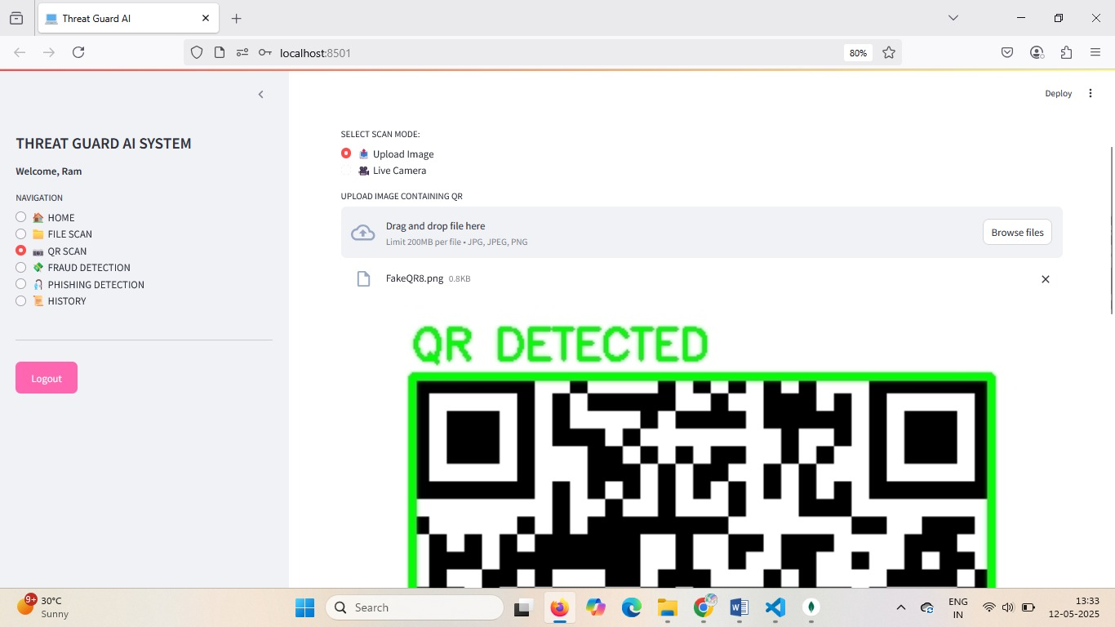
QR Fraud Detection - Unsafe

Slide 20
QR Fraud Detection - Safe

Slide 21
PDF Malware Detection – Unsafe

Slide 22
PDF Malware Detection – Safe

Slide 23
Phishing Detection – Unsafe

Slide 24
Phishing Detection – Safe

Slide 25
Conclusion
AI-driven fraud detection significantly enhances accuracy and reduces financial losses.
Robust fraud detection is essential for maintaining financial security and customer trust.
Future Scope
Secure Banking API Integration: Enable real-time analysis via secure connections to banking APIs.
Blockchain for Transaction Verification: Explore using blockchain for immutable and transparent UPI transaction verification.
AI-Powered Anomaly Detection (API Data): Apply advanced AI to API data for early fraud identification.
Privacy-Preserving Blockchain Analytics: Investigate privacy-focused blockchain techniques for secure fraud analysis.

Slide 26
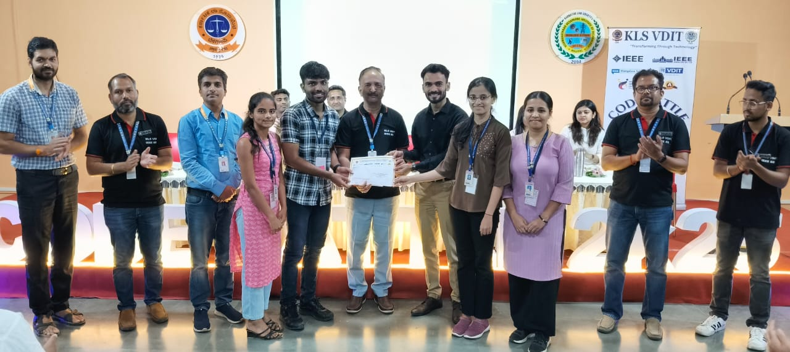
Winner of Code Battle Hackathon

Slide 27
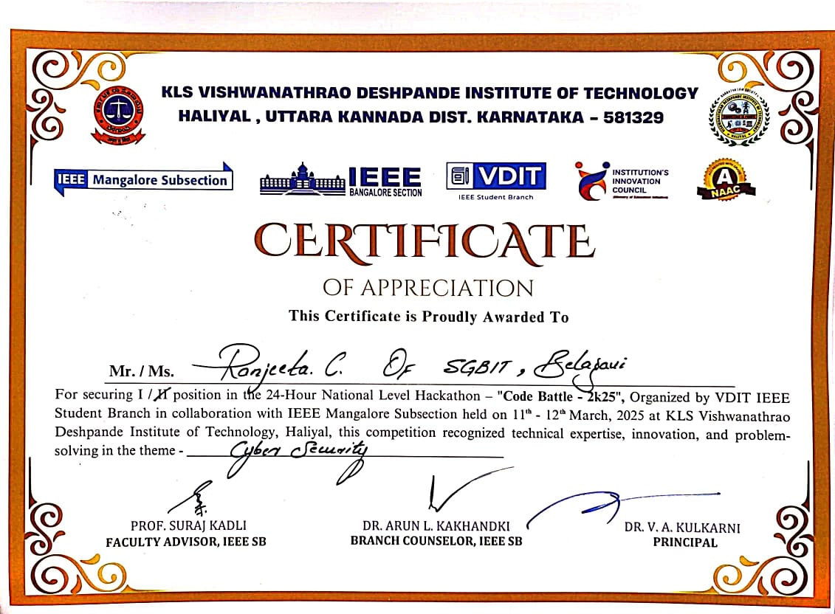

Slide 28


Slide 29
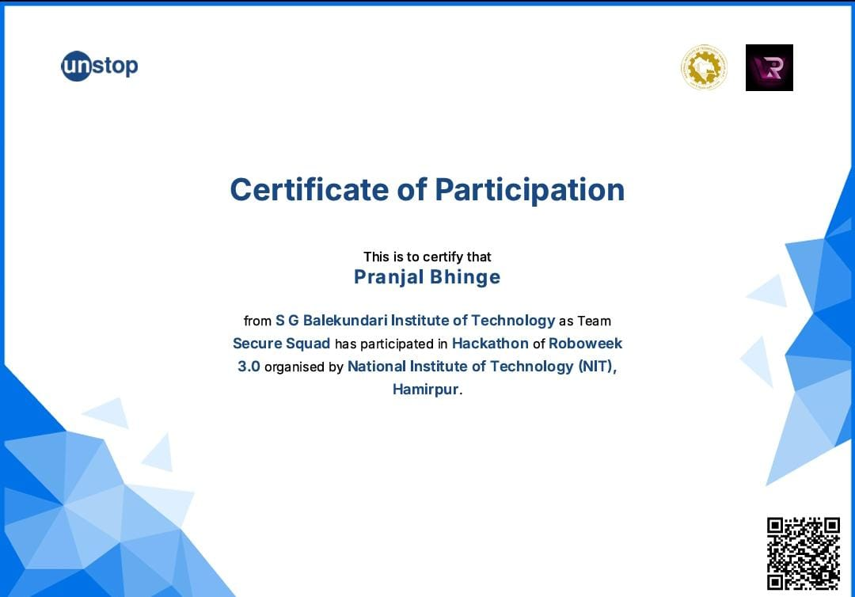

Slide 30
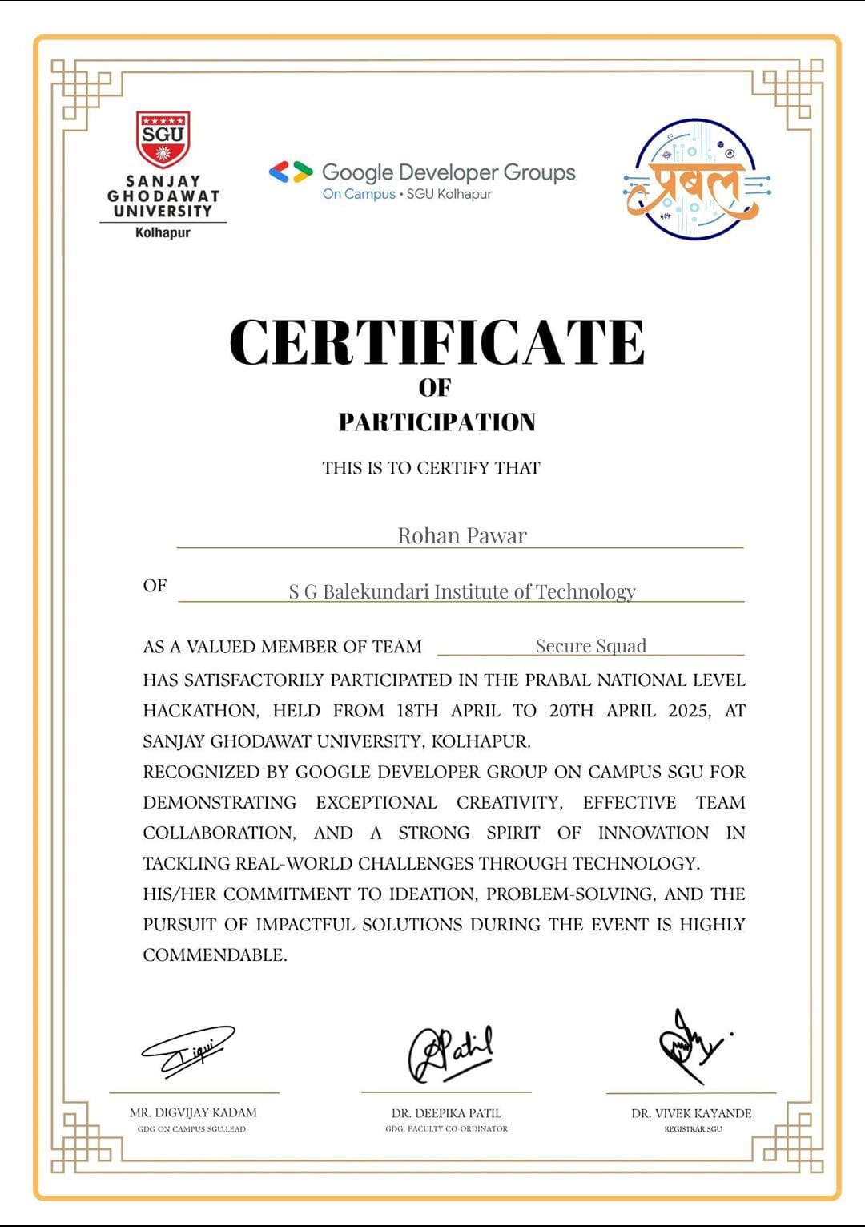

Slide 31
THANK YOU

